Slide 1
Overview Data Repositories

Slide 2
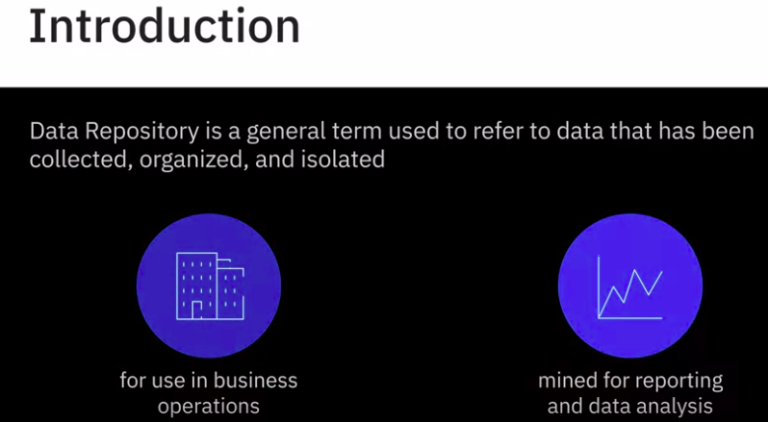
7. Overview Data Repositories

Slide 3
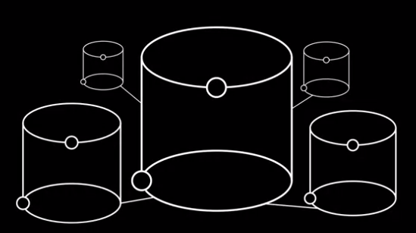
7. Overview Data Repositories
It can be a small or large database infrastructure with one or more databases that collect, manage, and store datasets

Slide 4
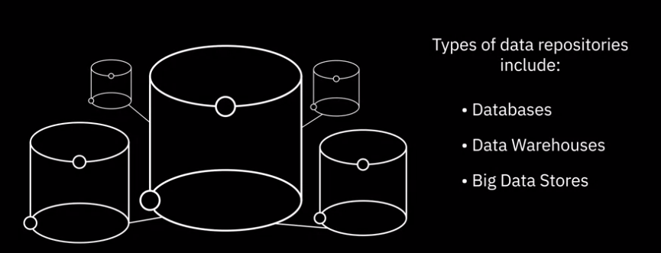
7. Overview Data Repositories

Slide 5
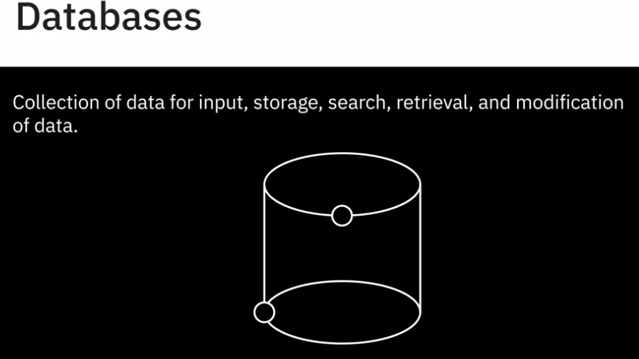
7. Overview Data Repositories - Databases

Slide 6
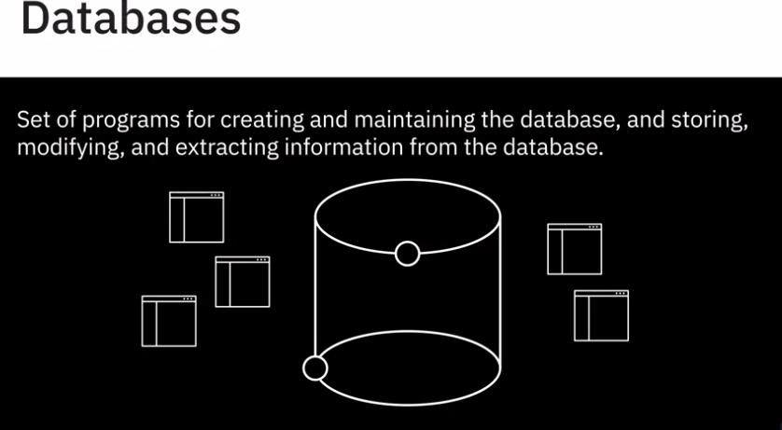
7. Overview Data Repositories - Databases
And a Database Management System, or DBMS, is a set of programs that creates and maintains the database. It allows you to store, modify, and extract information from the database using a function called querying.

Slide 7
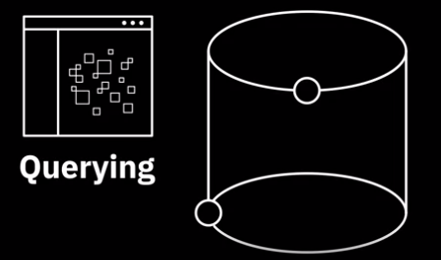
7. Overview Data Repositories - Databases - Query
For example, if you want to find customers who have been inactive for six months or more, using the query function, the database management system will retrieve data of all customers from the database that have been inactive for six months and more
Even though a database and DBMS mean different things, the terms are often used interchangeably.

Slide 8
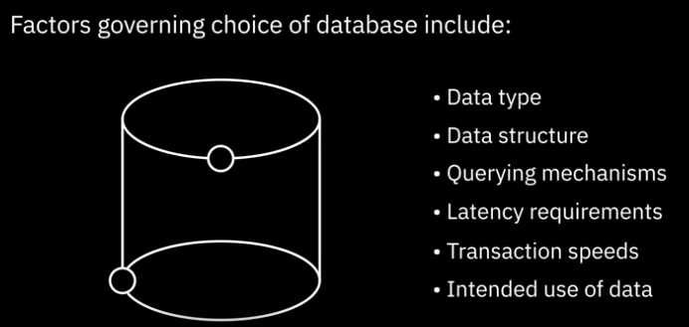
7. Overview Data Repositories - Databases - Different types

Slide 9
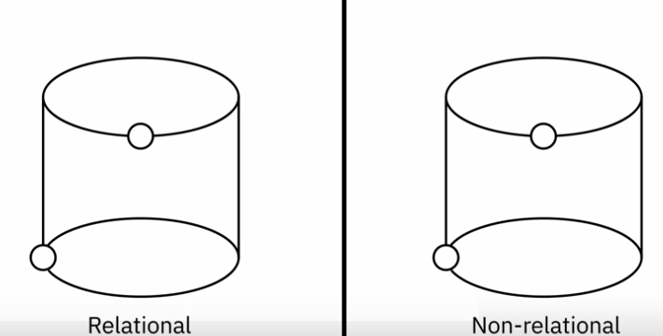
7. Overview Data Repositories - Databases - main types of databases

Slide 10
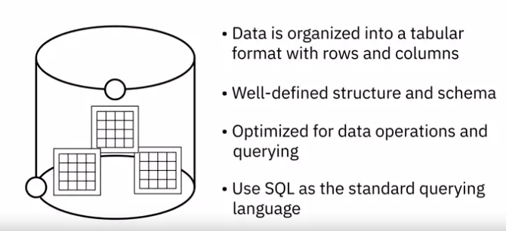
7. Overview Data Repositories - Databases - Relational
Relational databases, also referred to as RDBMSes

Slide 11
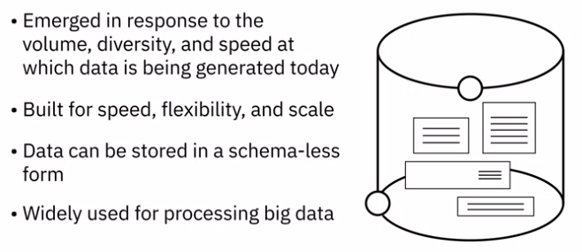
7. Overview Data Repositories - Databases - Non-Relational
non-relational databases, also known as NoSQL, or “Not Only SQL”.

Slide 12
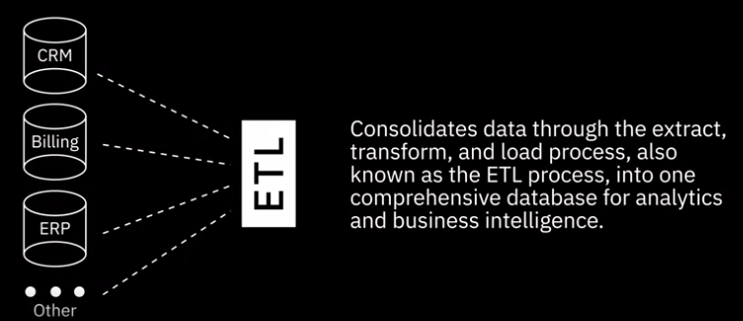
7. Overview Data Repositories - Data Warehouse - ETL
A data warehouse works as a central repository that merges information coming from disparate sources and consolidates it through ETL process

Slide 13
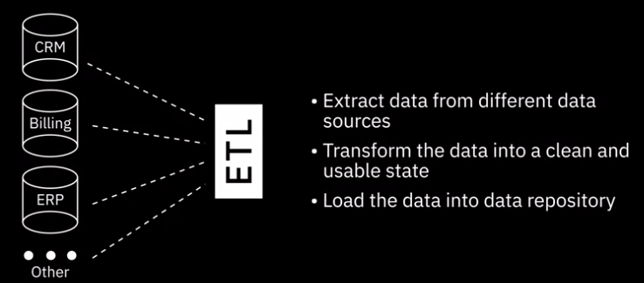
7. Overview Data Repositories - Data Warehouse - ETL

Slide 14
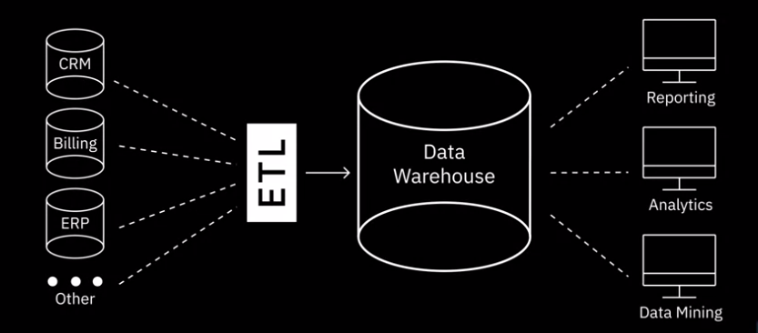
7. Overview Data Repositories - Data Warehouse
Related to Data Warehouses are the concepts of Data Marts and Data Lakes, which we will cover later.

Slide 15
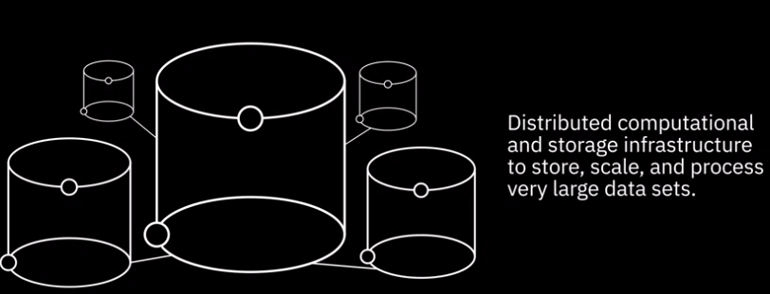
7. Overview Data Repositories - Big Data Stores

Slide 16
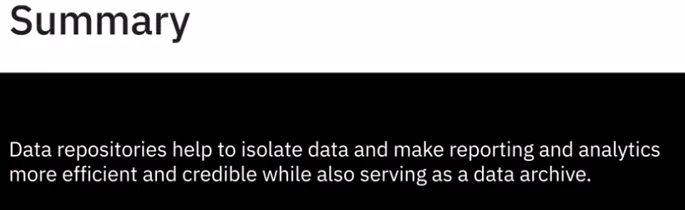
7. Overview Data Repositories - Summary

Slide 17
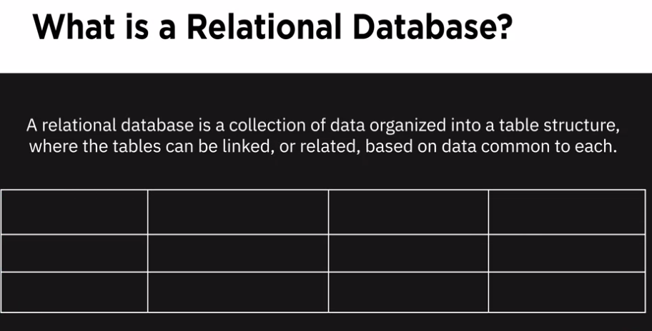
8. Relational Database Management Systems (RDMS)

Slide 18
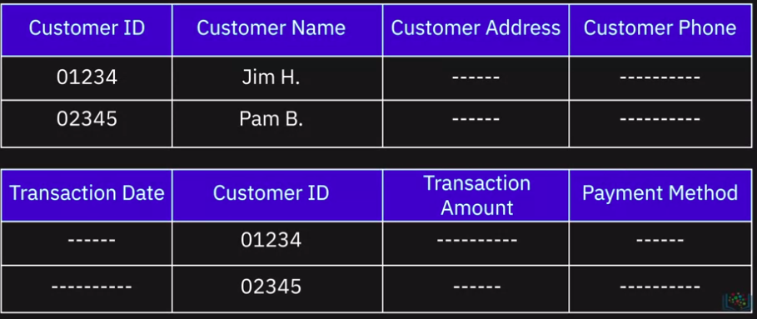
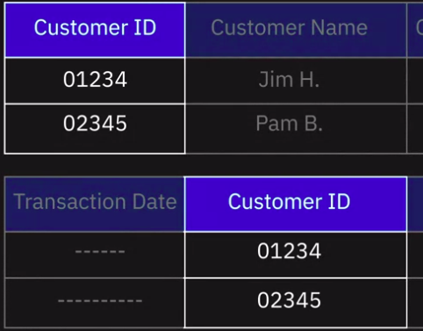
8. RDMS - Relational Databases
The customer table and the transaction tables can be related based on the common Customer ID field. You can query the customer table to produce reports such as a customer statement that consolidates all transactions in a given period.

Slide 19
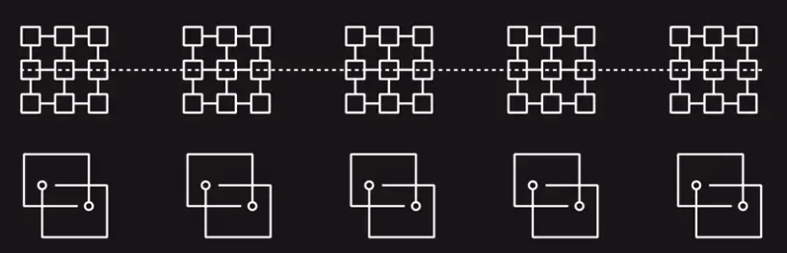
8. RDMS - Relational Databases
This capability of relating tables based on common data enables you to retrieve an entirely new table from data in one or more tables with a single query.
→ It also allows you to understand the relationships among all available data and gain new insights for making better decisions

Slide 20
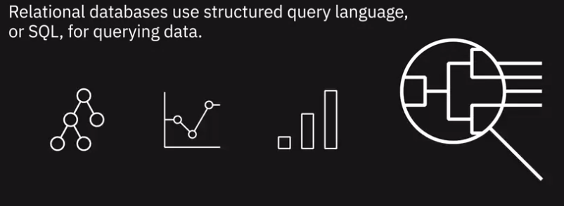
8. RDMS - Relational Databases

Slide 21
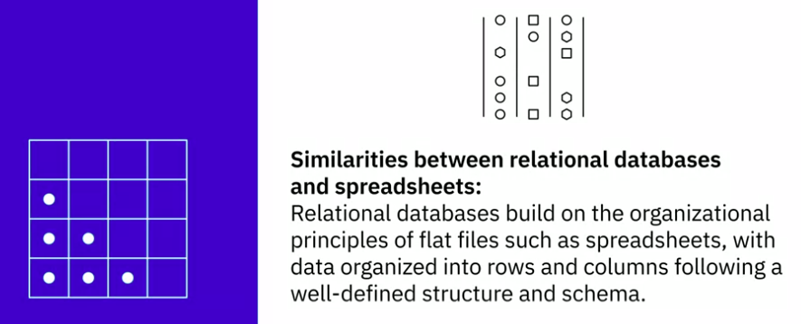
8. RDMS - Relational Databases

Slide 22
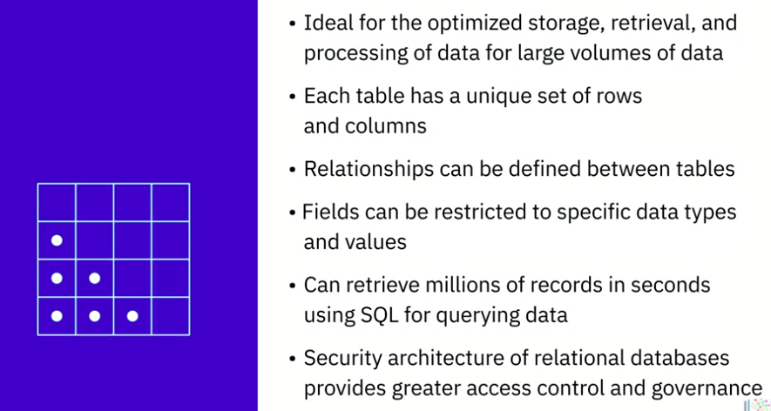
8. RDMS - Relational Databases

Slide 23
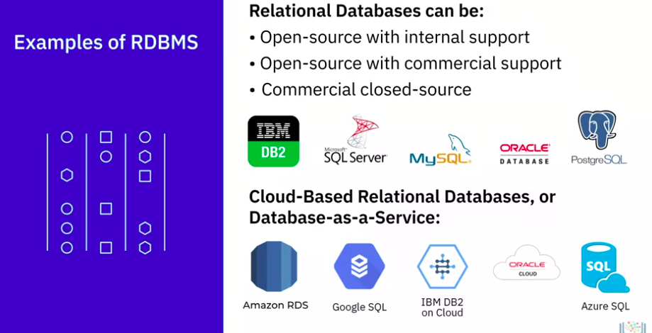
8. RDMS - Relational Databases

Slide 24
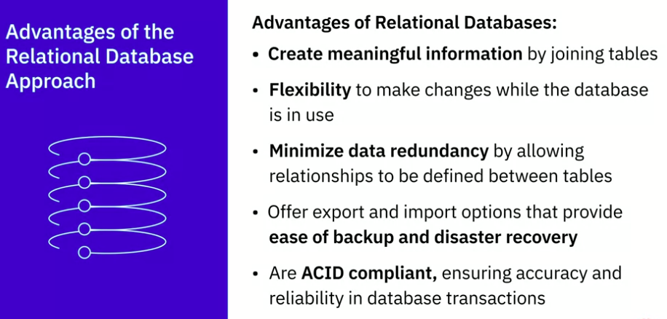
8. RDMS - Relational Databases - Advantages
ACID (atomicity, consistency, isolation, and durability)

Slide 25
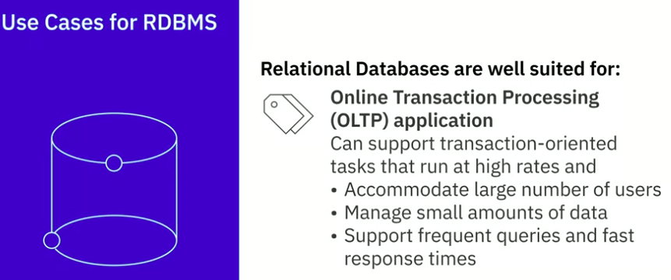
8. RDMS - Relational Databases - Use cases

Slide 26
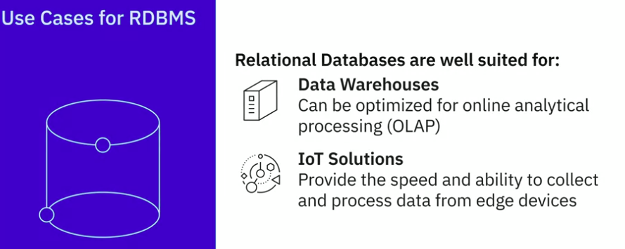
8. RDMS - Relational Databases - Use cases

Slide 27
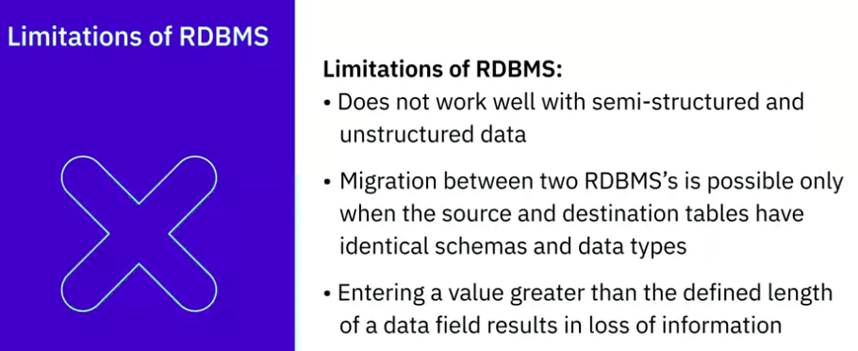
8. RDMS - Relational Databases - Limitation
NOTE
Despite the limitations and the evolution of data in these times of big data, cloud computing, IoT devices, and social media, RDBMS continues to be the predominant technology for working with structured data.

Slide 28
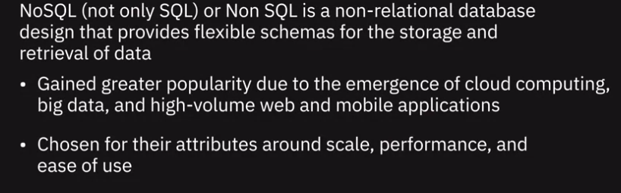
9. NoSQL

Slide 29
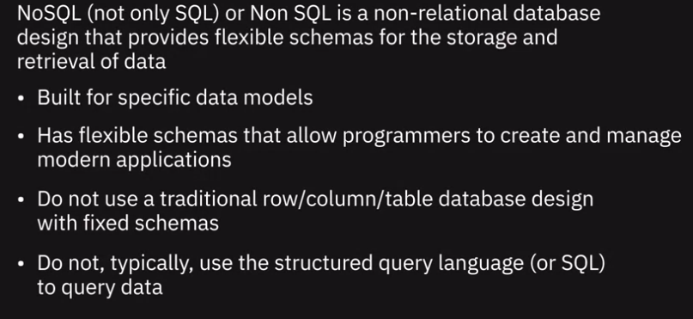
9. NoSQL

Slide 30
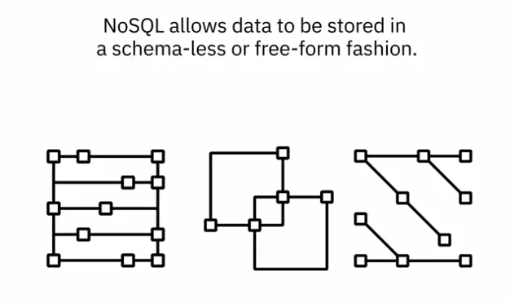
9. NoSQL
NoSQL allows data to be stored in a schema-less or free-form fashion. Any data, be It structured, semi-structured, or unstructured,can be stored in any record.

Slide 31
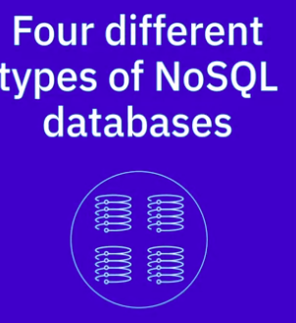
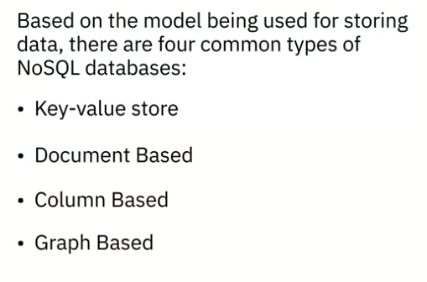
9. NoSQL - 4 different types

Slide 32
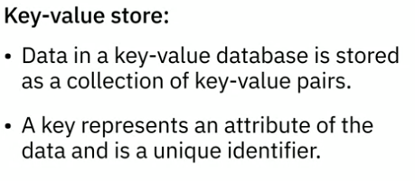
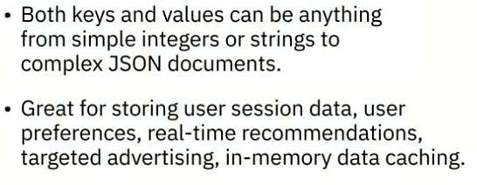
9. NoSQL - 4 different types - Key-value store

Slide 33
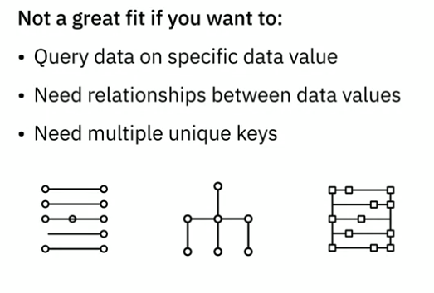
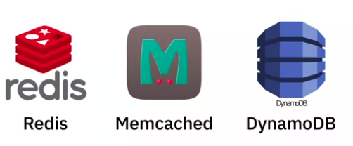
9. NoSQL - 4 different types - Key-value store
Aws

Slide 34
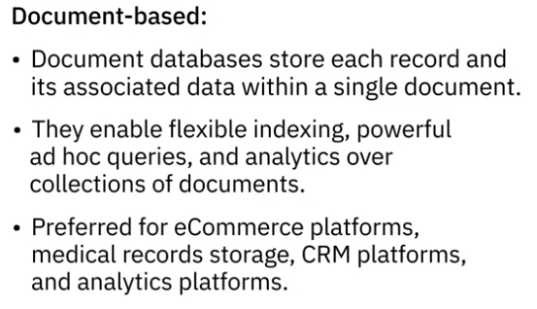
9. NoSQL - 4 different types - Document-Based

Slide 35
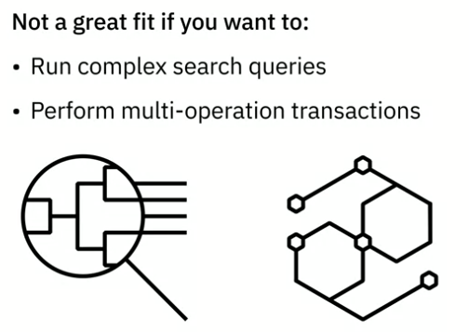
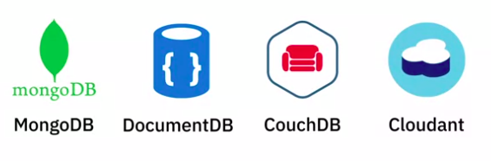
9. NoSQL - 4 different types - Document-Based
AWS
some of the popular document-based databases

Slide 36
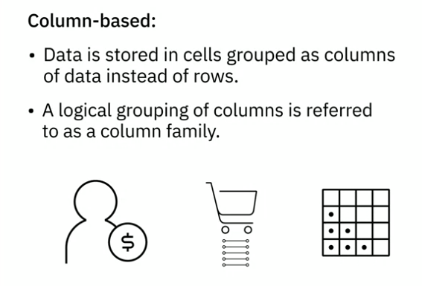
9. NoSQL - 4 different types - Column-Based
For example, a customer’s name and profile information will most likely be accessed together but not their purchase history. So,customer name and profile information data can be grouped into a column family.

Slide 37
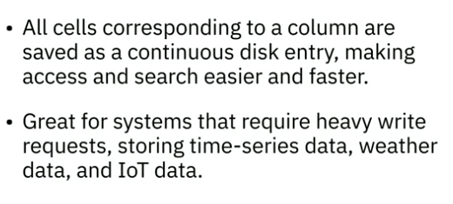
9. NoSQL - 4 different types - Column-Based

Slide 38
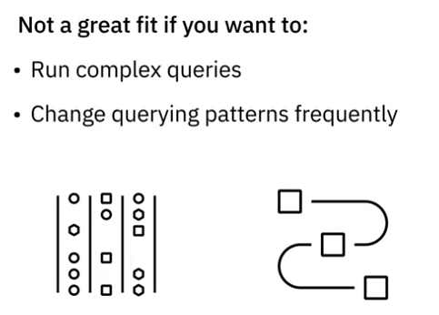

9. NoSQL - 4 different types - Column-Based

Slide 39
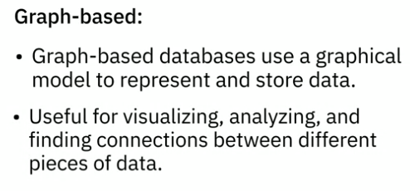
9. NoSQL - 4 different types - Graph-based

Slide 40
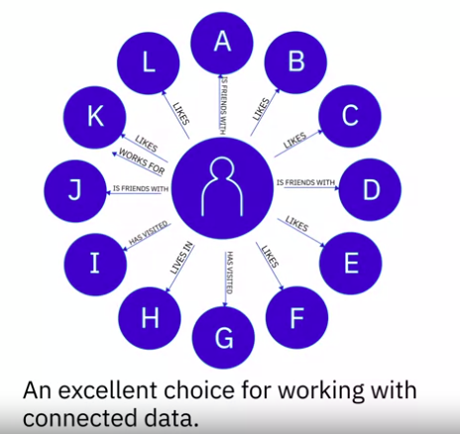
9. NoSQL - 4 different types - Graph-based
Graph databases are an excellent choice for working with connected data, which is data that contains lots of interconnected relationships

Slide 41
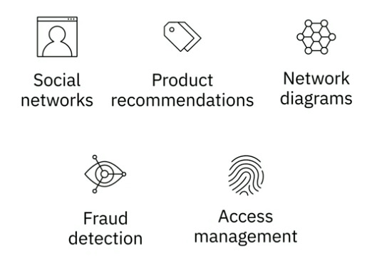
9. NoSQL - 4 different types - Graph-based

Slide 42
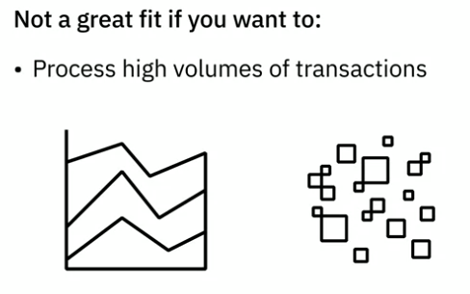
9. NoSQL - 4 different types - Graph-based
But if you want to process high volumes of transactions, it may not be the best choice for you, because graph databases are not optimized for large-volume analytics queries.

Slide 43
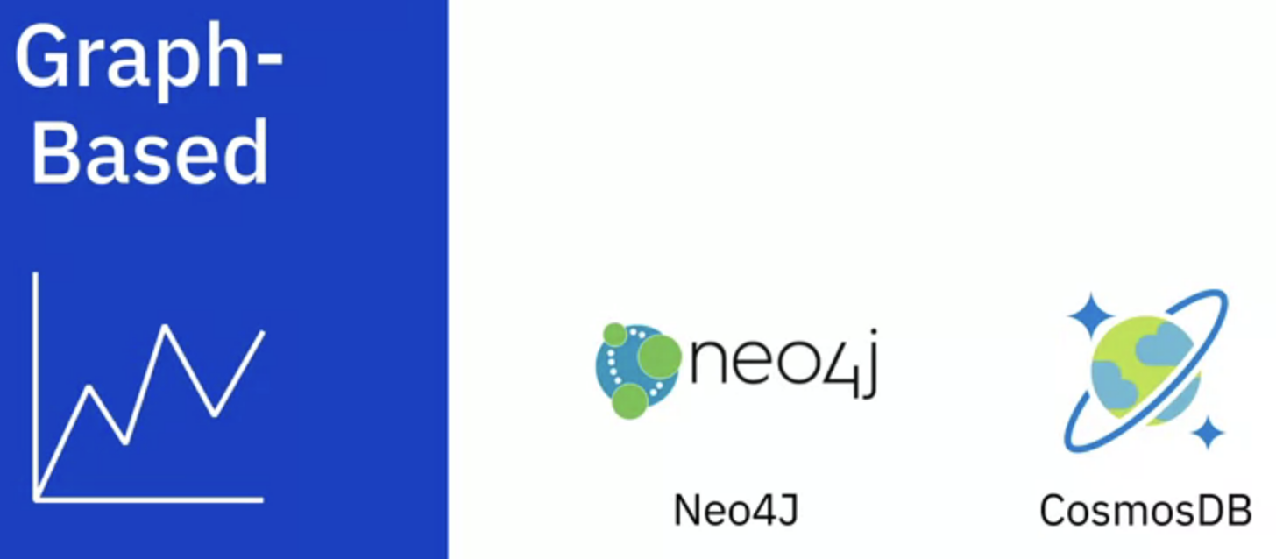
9. NoSQL - 4 different types - Graph-based

Slide 44
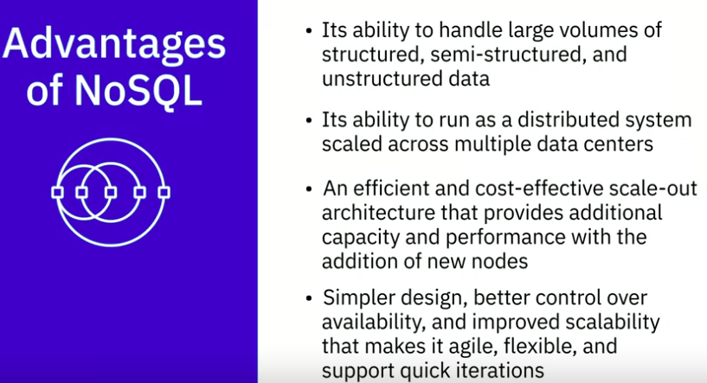
9. NoSQL - Advantages

Slide 45
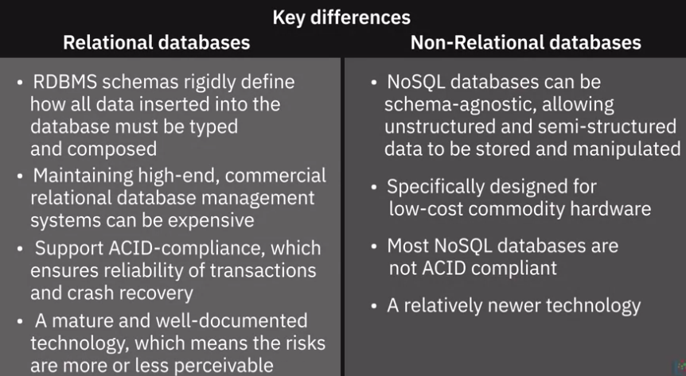
9. NoSQL - relational and non-relational

Slide 46
10. ACID-compliant (Atomicity, Consistency, Isolation and Durability) - Atomicity
Atomicity: Database transactions, like atoms, can be broken down into smaller parts. When it comes to your database, atomicity refers to the integrity of the entire database transaction, not just a component of it. In other words, if one part of a transaction doesn’t work like it’s supposed to, the other will fail as a result—and vice versa.
For example, if you’re shopping on an e-commerce site, you must have an item in your cart in order to pay for it. What you can’t do is pay for something that’s not in your cart. (You can add something into your cart and not pay for it, but that database transaction won’t be complete, and thus not ‘atomic’, until you pay for it).

Slide 47
10. ACID-compliant (Atomicity, Consistency, Isolation and Durability) - Consistency
Consistency: For any database to operate as it’s intended to operate, it must follow the appropriate data validation rules. Thus, consistency means that only data which follows those rules is permitted to be written to the database.
If a transaction occurs and results in data that does not follow the rules of the database, it will be ‘rolled back’ to a previous iteration of itself (or ‘state’) which complies with the rules.
On the other hand, following a successful transaction → new data will be added to the database and the resulting state will be consistent with existing rules.

Slide 48
10. ACID-compliant (Atomicity, Consistency, Isolation and Durability) - Isolation
Isolation: For a database, isolation refers to the ability to concurrently process multiple transactions in a way that one does not affect another.
For example: imagine you and your neighbor are both trying to buy something from the same e-commerce platform at the same time. There are 10 items for sale: your neighbor wants five and you want six. Isolation means that one of those transactions would be completed ahead of the other one.
In other words, if your neighbor clicked first, they will get five items, and only five items will be remaining in stock. So you will only get to buy five items.
If you clicked first, you will get the six items you want, and they will only get four.
→ Thus, isolation ensures that eleven items aren’t sold when only ten exist

Slide 49
10. ACID-compliant (Atomicity, Consistency, Isolation and Durability) - Durability
Durability: In databases that possess durability, data is saved once a transaction is completed, even if a power outage or system failure occurs.
For example: Imagine you’re buying in-demand concert tickets on a site similar to Ticketmaster.com. Right when tickets go on sale, you’re ready to make a purchase. After being stuck in the digital waiting room for some time, you’re finally able to add those tickets to your cart. You then make the purchase and get your confirmation.
However if that database lacks durability, even after your ticket purchase was confirmed, if the database suffers a failure incident your transaction would still be lost! As you might expect, this is a really bad thing to happen for an online e-commerce site,
so transaction durability is a must-have.

Slide 50
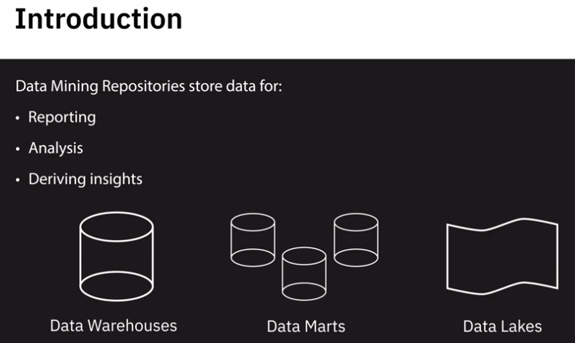
11. Data Warehouses, Data Marts, and Data Lakes

Slide 51

11. Data Warehouses
A data warehouse is a central repository of data integrated from multiple sources. Data warehouses serve as the single source of truth—storing current and historical data that has been cleansed, conformed, and categorized

Slide 52

11. Data Warehouses
When data gets loaded into the data warehouse, it is already modeled and structured for a specific purpose, meaning it's analysis-ready.
Traditionally, data warehouses are known to store relational data from transactional systems and operational databases such as CRM, ERP, HR, and Finance applications.
But with the emergence of NoSQL technologies and new data sources, non-relational data repositories are also being used for data warehousing

Slide 53

11. Data Warehouses - 3-tier architecture
This tier includes all the tools and applications used for querying, reporting, and analyzing data.
OLAP: Online Analytical Processing

Slide 54

11. Data Warehouses - cloud based
In response to the rapid data growth and today's sophisticated analytics tools, data warehouses that once resided in on-premise data centers are moving to the cloud.

Slide 55

11. Data Warehouses - Popular Data Warehouses

Slide 56

11. Data Mart

Slide 57

11. Data Mart - Dependent Data Marts

Slide 58

11. Data Mart - Independent Data Marts

Slide 59

11. Data Mart - Hybrid

Slide 60

11. Data Mart
The difference also lies in how data is extracted from the source systems, the transformations that need to be applied, and how the data is transported into the mart.

Slide 61

11. Data Mart
Dependent Data Marts, for example, pull data from an enterprise data warehouse, where data has already been cleaned and transformed

Slide 62

11. Data Mart
Independent Data Marts need to carry out the transformation process on the source data since it is coming directly from operational systems and external sources.

Slide 63

11. Data Mart - Applications

Slide 64

11. Data Lakes
While a data warehouse stores data that has been cleaned, processed, and transformed for a specific need, you do not need to define the structure and schema of data before loading into the data lake. Which does not mean that a data lake is a place where data can be dumped without governance.

Slide 65

11. Data Lakes

Slide 66

11. Data Lakes - Benefits

Slide 67

11. Data Lakes

Slide 68

11.Conclusion
While they all have a similar goal:
they need to be evaluated within the context of the use case and technology infrastructure for selecting the one that works best for an organization’s needs.

Slide 69

12. ETL / ELT / Data Pipeline

Slide 70

12. Extract, Transform, Load - ETL
While ETL is a generic process, the actual job can be very different in usage, utility, and complexity

Slide 71

12. ETL - Extract - Batch Processing
Extract is the step where data from source locations is collected for transformation

Slide 72

12. ETL - Extract - Stream Processing

Slide 73

12. ETL - Transform
enriching data, for example, splitting full name to first, middle, and last names

Slide 74

12. ETL - Load

Slide 75

12. ETL - Load
It is vital to keep an eye on load failures and ensure the right recovery mechanisms are in place.

Slide 76

12. ETL
ETL has historically been used for batch workloads on a large scale. However, with the emergence of streaming ETL tools, they are increasingly being used for real-time streaming event data as well

Slide 77

12. ETL - Popular tools

Slide 78

12. Extract, Load, Transform (ELT) Process
In the ELT process, extracted data is first loaded into the target system, and transformations are applied in the target system.
The destination system for an ELT pipeline is most likely a data lake, though it can also be a data warehouse

Slide 79

12. Extract, Load, Transform (ELT) Process
It is ideal for data lakes where transformations on the data are applied once the raw data is loaded into the data lake

Slide 80

12. ELT - Advantages

Slide 81


12. Data Pipeline
which ETL and ELT may be subsets

Slide 82

12. Conclusion

Slide 83

13. Data Integration

Slide 84

13. Data Integration

Slide 85

13. Data Integration

Slide 86

13. Data Integration - Example
to make customer data available for analytics, you would need to extract individual customers' information from operational systems such as sales, marketing, and finance. You would then need to provide a unified view of the combined data so that your users can access, query, and manipulate this data from a single interface to derive statistics, analytics, and visualizations

Slide 87

13. Data Integration - Workflow
How does a data integration platform relate to ETL and data pipelines?
Data integration combines disparate data into a unified view of the data.
Data pipeline covers the entire data movement journey from source to destination systems. In that sense, you use a data pipeline to perform data integration.
ETL is a process within data integration.

Slide 88

13. Data Integration - Capabilities
An extensive catalog of pre-built connectors and adopters that help you connect and build integration flows with a wide variety of data sources such as databases, flat files, social media data, APIs, CRM and ERP applications.

Slide 89

13. Data Integration - Tools

Slide 90

13. Data Integration - Tools

Slide 91

13. Data Integration - Tools

Slide 92

13. Data Integration - Tools

Slide 93

13. Data Integration - Conclusion

Slide 94

14. Viewpoint: Tools, Databases and Data Repositories
Of Choices

Slide 95

14. Viewpoint: Tools, Databases and Data Repositories
Of Choices

Slide 96

14. Viewpoint: Tools, Databases and Data Repositories
Of Choices

Slide 97

14. Viewpoint: Tools, Databases and Data Repositories Of Choices

Slide 98

15. Done to create the instance Db2 in IBM clound
https://cf-courses-data.s3.us.cloud-object-storage.appdomain.cloud/IBM-DB0100EN-SkillsNetwork/labs/1.2.2.9_Hands-on_Lab_Provision_an_instance_of_IBM_Db2_Lite_plan.md.html?origin=www.coursera.org

Slide 99

Recap

Slide 100

Quiz

Slide 101

Quiz

Slide 102

Quiz

Slide 103

Quiz

Slide 104

Quiz

Slide 105

Quiz

Slide 106

Quiz

Slide 107

Quiz

Slide 108

Quiz

Slide 109

Quiz

Slide 110

Quiz

